Slide 1

GOKARAJU RANGARAJU INSTITUTE OF ENGINEERING AND TECHNOLOGY
Department of Computer Science and Engineering
Major Project Phase II

Slide 2
Title : Intrusion Detection in
Network & Server
Name of the Student | H.T.Number
Mohd Muzammil | 19241A0587
Jakka Arun | 20245A0511
Sidharth Nookala | 19241A05A7
Raj Mohan | 19241A05B3
Under the Guidance of
Dr.K.Butchi Raju
Professor
Dept. of CSE

Slide 3

Presentation Outlines
Abstract
Existing Approach
Proposed Approach
Architecture
Implementation
Simple Interface

Slide 4
Abstract
The most sensitive and important data are stored on servers; strong security is required to avoid data theft and misuse. When an intrusion occurs in a system, an intrusion detection system (IDS) is used to identify it and alert the admin. A network and devices are inspected by an IDS for malicious activity or policy breaches. Any unlawful behaviour or a violation is often captured continuously using a security information and event management system and notified to an admin. In order to differentiate between hostile behaviour and spurious reports, a SIEM system aggregates outputs from many sources and use event filtering algorithms. In order to track traffic to and from all networked devices, intrusion detection systems (IDS) are installed at one or more strategically located locations inside the network. Our study is on UNSW_NB15 dataset which comprises of different attacks

Slide 5
Existing Approach
The current existing is signature-based intrusion detection system are being loaded with some fixed number of attack types and are used to detect those. The amount of bytes, number of ones, or number of zeros in the network traffic are only a few examples of the particular patterns that signature-based IDS uses to identify attacks. Additionally, it identifies based on the malware's already-known harmful instruction sequence. Signatures are the patterns that the IDS has identified. A network packet contains a lot of information, many mathematical calculations have to be done in order to process the code for a new attack category. In the current world the replications of new viruses, worms with very little configuration changes are becoming common in the cyber world.
Developing such a system requires a lot of coding effort
Cost of maintenance is expensive
The Signature Library needs to be continually updated to detect the threats.

Slide 6
Proposed Approach
We developed a machine learning-based intrusion detection with a very much reduced coding effort. Introducing a new anomaly or attack type into the system is very easy. Just training the system with the new attack category one time is enough. If any intrusions of that type happen the system detects it a good accuracy of approximately 90%. The system can perfectly determine which packet is normal. So whenever there happens any intrusion, the system may not detect the type of intrusion perfectly but it can perfectly differentiate the packet as an anomalous packet and raises an alert.
Cost of maintenance is low.
It is effective in identifying unknown threats or even known attack variations.
Provides a additional layer of protection with more security.
Developing such a system requires a less of coding effort

Slide 7
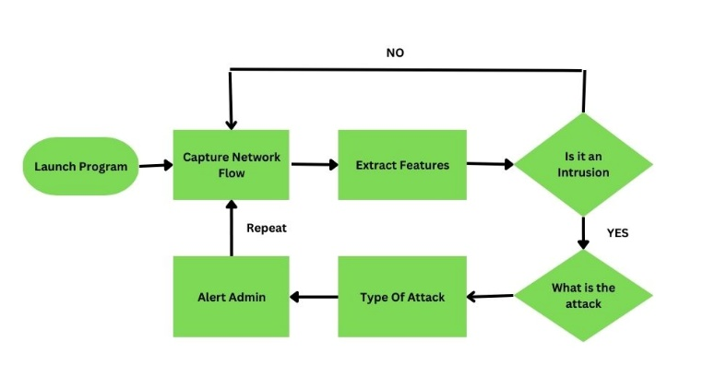

Architecture

Slide 8
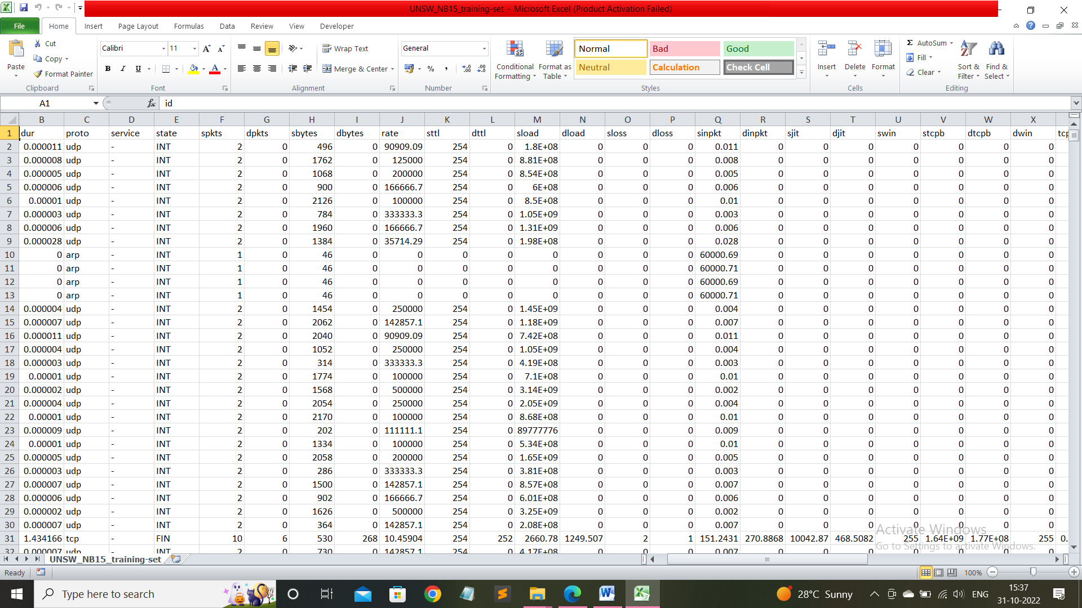
Implementation
Dataset
The datasets used in the project are UNSW-NB-15 for all training and testing . The UNSW-NB-15 dataset has packet information related to 10 different types of attacks.

Slide 9
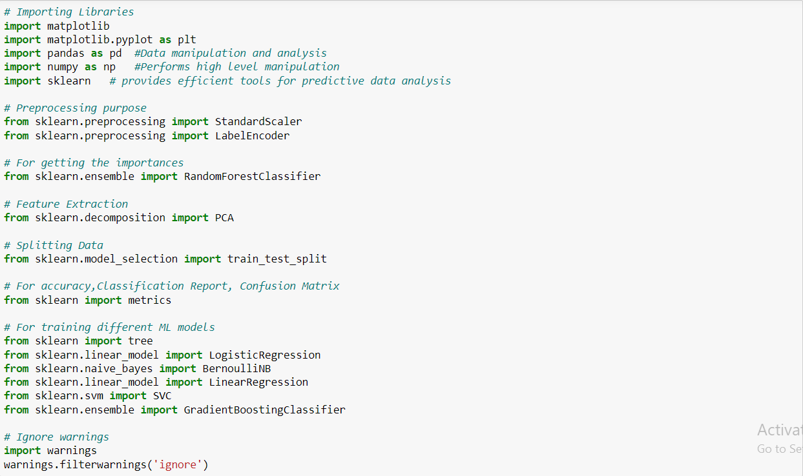
Importing Modules
NumPy
Pandas
Matplotlib
Scikit-learn
Warnings

Slide 10
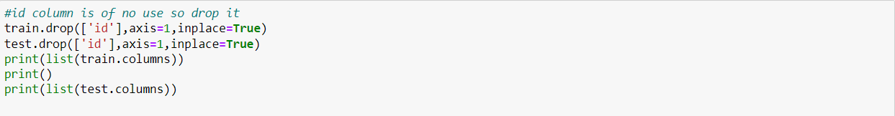
Uploading DataSet
Pre-processing the data

Slide 11
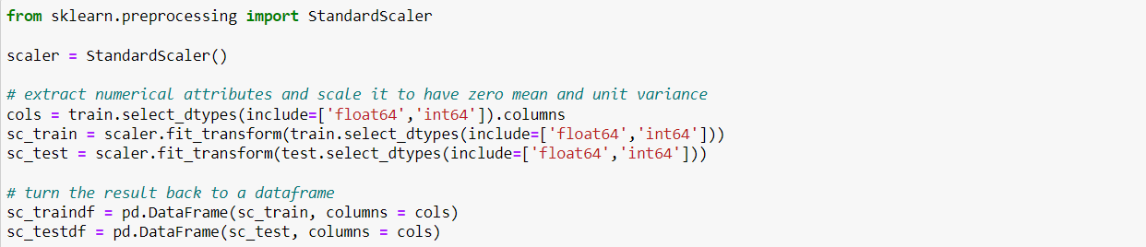
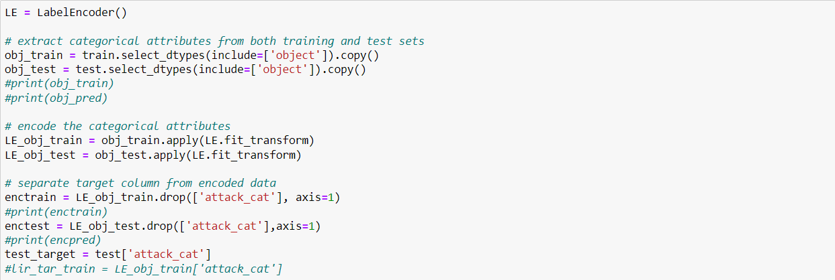
Standard Scaling
Label Encoding

Slide 12
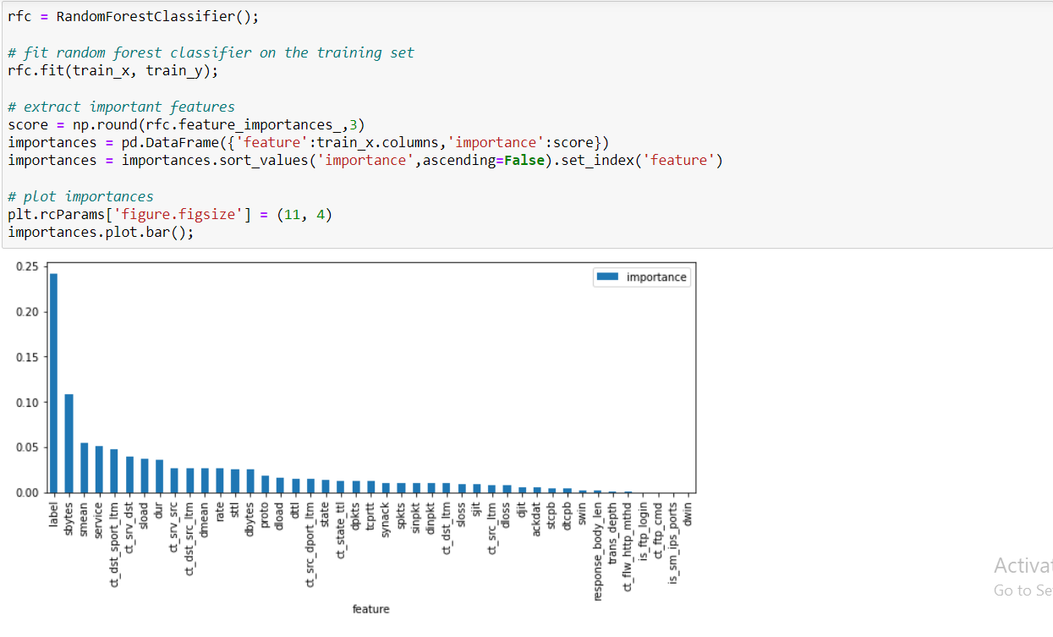
Plotting Importances

Slide 13
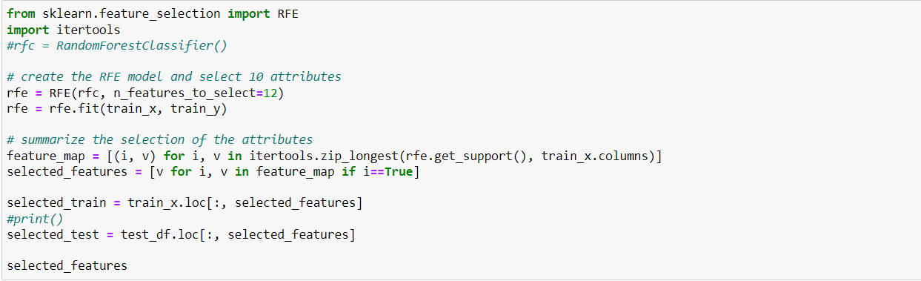
Feature Selection
Splitting for training and testing

Slide 14
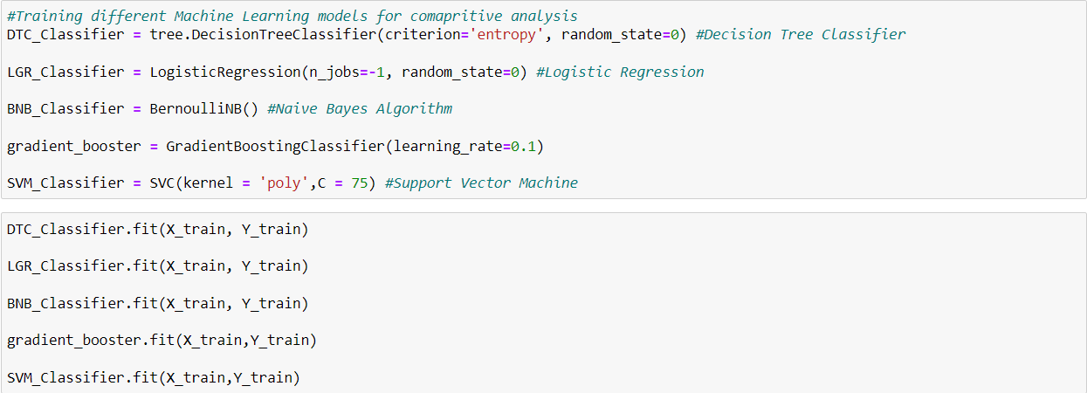
Creating machine learning models for Comparative study
Five algorithms are used in this project:
1) Decision Tree
2) Logistic Regression
3) Naive Bayes
4) Gradient Booster Classification
5) Support Vector Machine

Slide 15
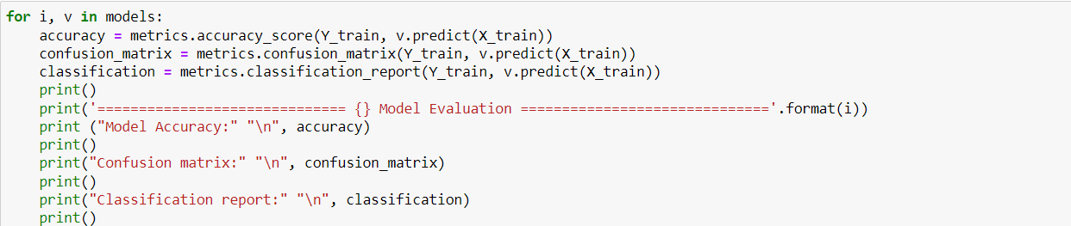
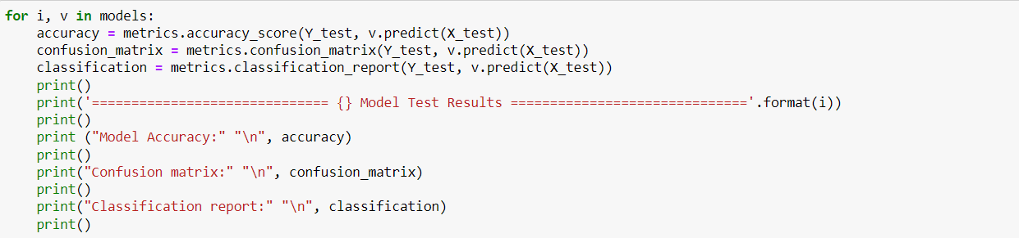
Training the models
Testing the models

Slide 16
Accuracy Of the Machine Learning Model
Model | Accuracy
Decision Tree | 88.66
Logistic Regression | 84.63
Naïve Bayes | 82.64
Gradient Booster Classification | 89.88
SVM | 87.62

Slide 17
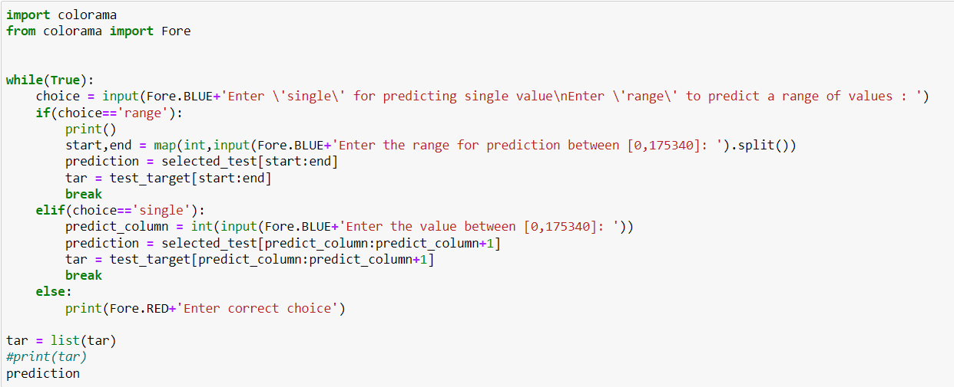
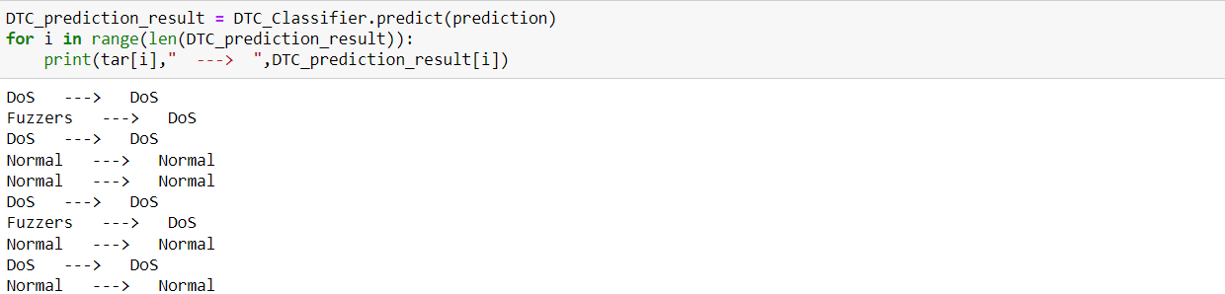
Test On new data

Slide 18
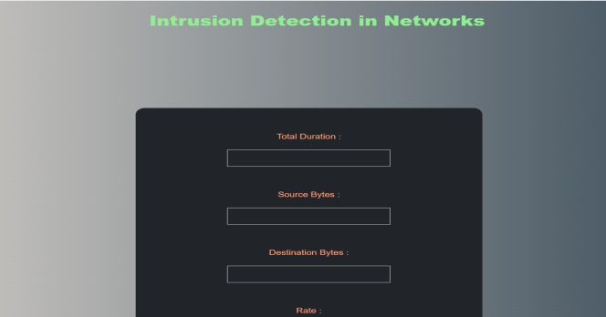
Simple Web Interface
Interface is built using : HTML , CSS , Django(python framework)

Slide 19

Prediction Result

Slide 20
References
[1] Martellini, Maurizio; Malizia, Andrea (2017-10-30). Cyber and Chemical, Biological, Radiological, Nuclear, Explosives Challenges: Threats and Counter Efforts. Springer. ISBN 9783319621081.
[2] Axelsson, S (2000). "Intrusion Detection Systems: A Survey and Taxonomy" (retrieved 21 May 2018)
[3] Newman, Robert (2009-06-23). Computer Security: Protecting Digital Resources. Jones & Bartlett Learning. ISBN 9780763759940.
[4 ] Mohammed, Mohssen; Rehman, Habib-ur (2015-12-02). Honeypots and Routers: Collecting Internet Attacks. CRC Press. ISBN 9781498702201.

Slide 21


